Slide 1
5COSC020W DATABASE SYSTEMS – LECTURE 01
Database Approach & Conceptual Database Design – Entity-Relationship Modelling

Slide 2
Lecture 01 – Outline
Database Systems
Databases, Database Management Systems, Database Applications.
Data Models.
Relational Model, XML Model, NoSQL Model, Object Model.
Database Design
Conceptual Design, Logical Design and Physical Design.
Conceptual Design for Relational Databases
Conceptual Entity-Relationship Modelling and ERDs.
Entities, relationships, multiplicity of a relationship: participation & cardinality.
Attributes, single & composite attributes, single-valued multi-valued, attributes.
Candidate keys, primary keys, alternate keys, compound keys, composite keys.

Slide 3
Database Systems
Database System = DB + DBMS + Database Applications
DB: Database
Collection of logically related data for business purpose
e.g. University Database
DBMS: Database Management System
IT system to create & manage DB and control access to DB
e.g. Oracle, MySQL, MS SQL Server, MongoDB
Database Application
Software that interacts with DBMS by sending requests to DBMS
e.g. student record system, VLE, library system, online timetabling, online retailer, medical appointment system, ticketing system
Student
stdtId
stdtFullName
0..*
takes
0..*
Module
moduleCode
moduleName
moduleDescrip
stdtId | stdFN
w12345 | Jim Bim
w12346 | Tim Lim
w12347 | Kim Lin

Slide 4
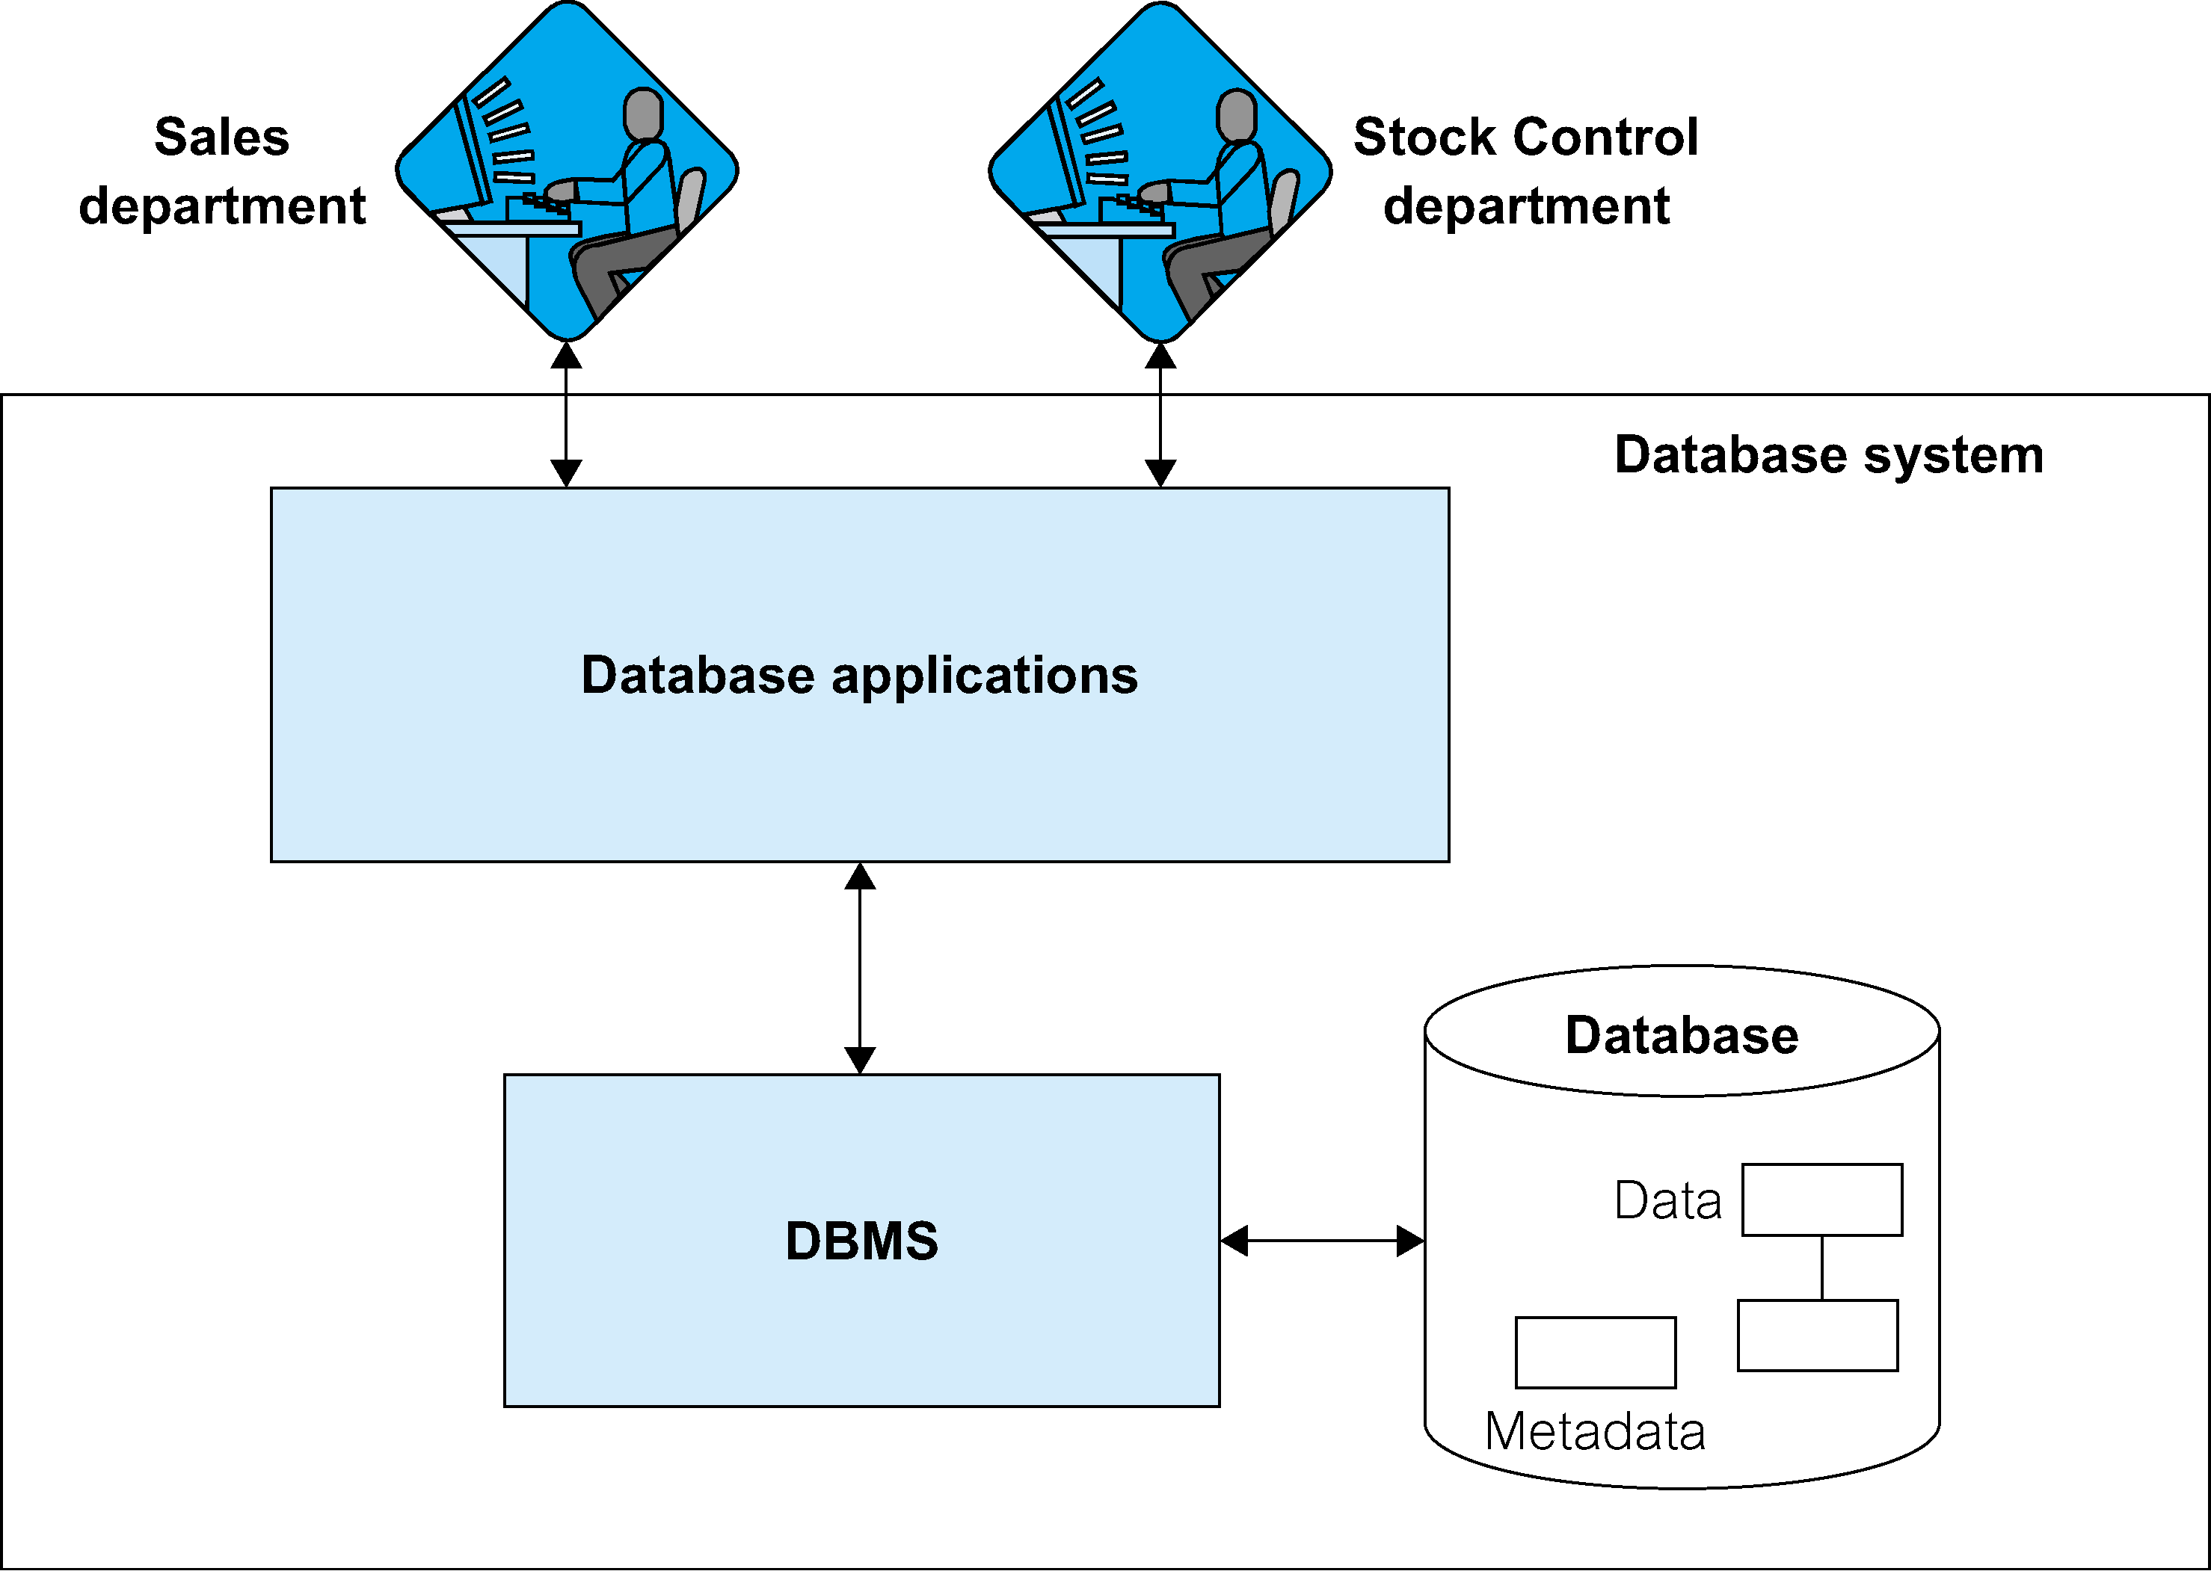
Database System
5COSC024W
Server-side
Web Development
5COSC020W
DATABASE
SYSTEMS

Slide 5
Database (DB)
Logically coherent collection of related data with inherent meaning.
Designed, built & populated to meet information needs of an organisation and to allow users to operate business transactions.
Abstraction of the real world i.e. representation of some aspect of the real world that is able to rapidly reflect changes.
Self-describing collection of integrated records: it stores data and metadata i.e. a description of this data

Slide 6
Database Management System (DBMS)
Software that allows users to:
Define a database Data Definition Language (DDL)
Specify data types, structures & constraints of the data
Specify the meta-data: description of the data
Construct a database Data Manipulation Language (DML)
Store data in storage medium controlled by DBMS
Manipulate a database Data Manipulation Language (DML)
Querying, updating and reporting on the data
Control access to a database Data Control Language (DCL)
Ensuring security, integrity, concurrency & recovery

Slide 7
Main characteristics of the database approach
Self-Describing Nature of a Database System
Relational databases: separation of data and meta-data stored in data dictionary.
NoSQL databases: self-describing data with data items & values in 1 structure.
Program Data Independence & Program Operation Independence
Relational databases: separation of structure of data and application program.
O.O. and object-relational databases: separation of implementation of an operation (method) from interface (includes operation names & parameters).
Data Model enables Data Abstraction
Conceptual representation of data to describe structure of the database.
It hides details of data storage and of implementation of operations from users.
Collection of concepts such as entities (or objects), their properties (attributes) and relationships to capture the data architecture.

Slide 8
Categories of Data Models
Conceptual Data Models
Concepts close to how users perceive data, independent from IT considerations.
e.g. entities, attributes and relationships.
Representational Data Models
Concepts understood by users but not too far from how data organised in computer.
e.g. tables, columns, primary and foreign keys.
Physical Data Models (not covered in this module)
Concepts that describe how data is organised in computer storage.
e.g. record formats, record ordering and access paths.
Self-describing Data Models
Combine description of data and data values in one structure.
e.g. XML, NoSQL databases.

Slide 9
Classifying DBMSs based on Data Models
Relational Model or SQL Model (covered in lectures 01-07)
Structured Data as collection of tables with fields, records, PKs and FKs.
Uses high level Structured Query Language (SQL) for CRUD operations.
XML Model (covered in lectures 08-10)
Semi-structured data as elements that can be nested to create tree structures.
Standard for structuring and exchanging data over the Web.
NoSQL Model (covered in lectures 11)
Key-value data model: each data value associated to unique key for fast retrieval.
Graph data model: data represented as graphs i.e. labelled nodes and edges.
Document data model: data as collection of documents in JSON or XML.
Object Model (not covered in this module)
Data as collection of objects (in classes) with properties & operations.

Slide 10

Database Design: producing a Data Model
IDEA
DATA MODEL
SYSTEM
Client
Archi-
tect
Deve-
loper
Database Analysis
Database Design
Database Implementation

Slide 11
Phases and outputs of Database Design
Data Requirements
BUSINESS USER’S DATA NEEDS
to support business processes
☑
CONCEPTUAL DESIGN
CONCEPTUAL DATA MODEL OR CONCEPTUAL SCHEMA
of the data required by business users
☑
LOGICAL DESIGN (Mapping)
LOGICAL DATA MODEL OR LOGICAL SCHEMA
based on specific file data organisation (e.g. relational model)

PHYSICAL DESIGN
PHYSICAL OR INTERNAL SCHEMA
storage structures, file organizations, indexes, access paths
☑
DATABASE IMPLEMENTATION & QUERYING
DATABASE IMPLEMENTED & QUERIED IN DBMS
data structures, constraints, data values, data description

Slide 12
Design for Relational Databases: E.R. Modelling
Entity-Relationship Modelling: top-down design approach to DB design
Representation of the data architecture to understand:
The nature of the data.
How data is stored and used by business.
Both for conceptual and logical design
Conceptual: entities, attributes, relationships, PKs.
Logical: relations (or tables), attributes (or columns), relationships, PKs and FKs.
Outcome: Entities-Relationship Diagrams (ERDs) or Schemas
Non technical and unambiguous.
Flexible enough to be understandable by both users and IT technologists.
Not tied to any technology or business methodology.

Slide 13
Step-by-step approach to Conceptual Design
Identity ENTITIES
Objects or things with independent existence on which data needs to be stored.
Identify RELATIONSHIPS
Meaningful associations between occurrences of entities.
Identify ATTRIBUTES
Properties of Entities (and sometimes of Relationships) that capture data values.
Identify PRIMARY KEYS (PKS)
Attribute that is a unique identifier, irreducible and selected.
Consider enhanced modelling concepts e.g. specialisations/generalisations
Check and remove redundancies

Slide 14
Entities
Student
Module
Entity
Building block of conceptual ERD.
Essential “business thing” of key importance for the firm to store data about.
Group of items with same properties that exists independently from each other.
Entity Occurrence
Uniquely identifiable instance of an entity
Example: w12345 Jim Bim, w12346 Tim Lim, w12347 Kim Lin
Example: 5COSC020W Database Systems, 5COSC024W Server-Side Web Dev

Slide 15
Relationships
Student
takes
Module
Relationship
Meaningful association between occurrences of entities.
It is conceptually essential for the business but it does need to have a physical existence.
Notations
Verb to indicate meaningful name.
Reading directionjust to help understanding the meaning, not an arrow!
Can be inverted with different verb, if meaning makes more sense.

Slide 16
Multiplicities
Student
takes
Module
7..*
0..*
Multiplicity
Number of possible occurrences of an entity related to a single occurrence of the other entity.
Represents the business rules or policies of the business.
Multiplicity = Participation + Cardinality
Participation: for one occurrence of an entity, minimum number of occurrences of other entities it is related to.
Cardinality: for one occurrence of an entity, maximum number of occurrences of other entities it is related to.

Slide 17
Example of multiplicities (1)
Student
takes
Module
7..*
0..*
ONE Student may not be taking ANY Modules (Participation is 0)
It is possible for a student not to have selected modules yet or to be suspended.
ONE Student may be taking MANY Modules (Cardinality is *)
A student may take many modules e.g. 6 modules a year for 3 years.
ONE Module must have AT LEAST 7 Students (Participation is 7)
A module only exists if at least 7 students are registered on it: University rule.
ONE Module can have MANY Students on it (Cardinality is *)
It makes sense for a module to have multiple students taking it.

Slide 18
Example of multiplicities (2)
Student
is enrolled on
Degree
0..*
1..1
ONE Student must be enrolled on AT LEAST ONE Degree (Participation is 1)
A student must be signed on at least a programme to be considered a student.
ONE Student can be enrolled on AT MOST ONE Degree (Cardinality is 1)
It is not possible for a student to be enrolled on more than one Degree.
ONE Degree may have NO students enrolled on it (Participation is 0)
A degree may be brand new and has not recruited yet or may be currently frozen.
ONE Degree can have MANY students enrolled on it (Cardinality is *)
It makes sense for a degree to have multiple students enrolled on it.

Slide 19
Example of multiplicities (3)
Branch
has
Staff
0..1
0..*
ONE Branch may have NO Staff assigned to it (Participation is 0)
A branch may be brand new (not staffed yet) or underperforming (cleared out).
ONE Branch may have MANY Staff assigned to it (Cardinality is *)
A branch will typically have many staff allocated to work at that specific branch.
ONE Staff may NOT BE ASSIGNED TO ANY Branch (Participation is 0)
A staff may be working outside the branch system e.g. Director, Driver, IT support.
ONE Staff must be assigned to UP TO ONE Branch (Cardinality is 1)
The structure of the firm says that staff can only be given one branch, no more.

Slide 20
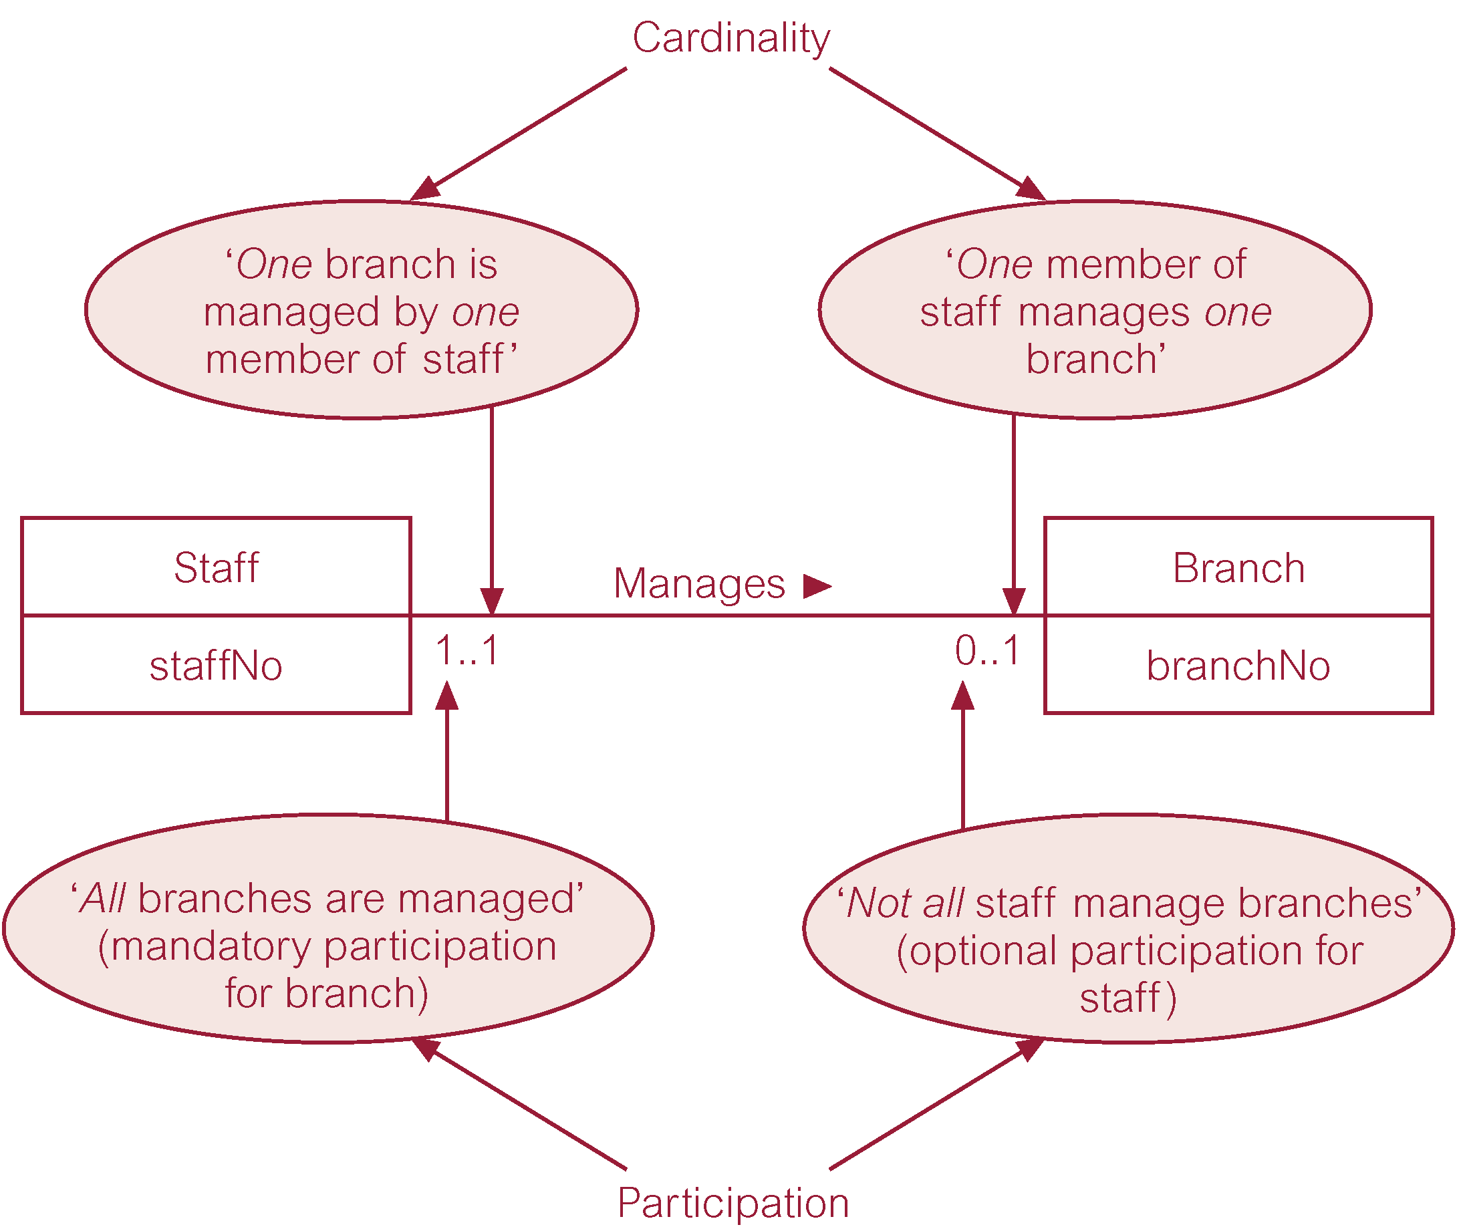
Example of multiplicities (4)

Slide 21
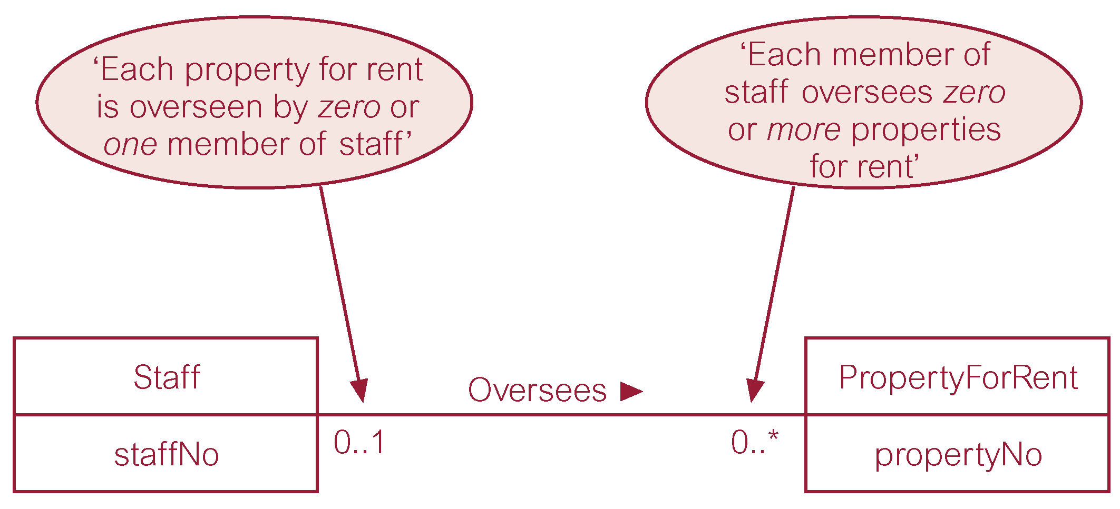
Example of multiplicities (5)

Slide 22
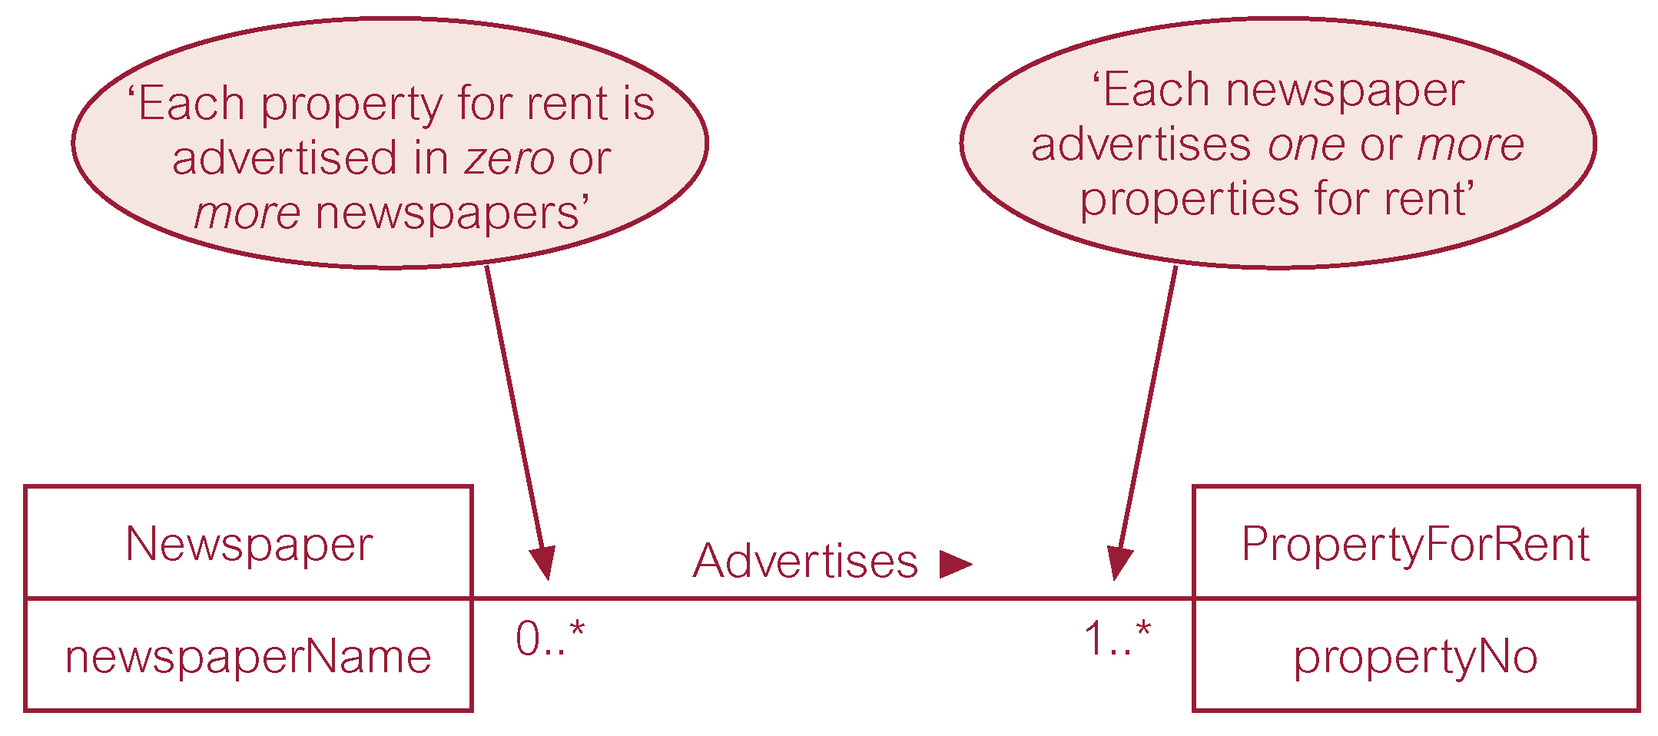
Example of multiplicities (6)

Slide 23
Attributes
Attribute
Property of an entity (or a relationship) that captures data value e.g. studentId, dob
Attribute Domain
Set of allowable values for one or more attributes
e.g. dob: date in range [01/01/1900 – 01/10/2021]
Simple Attribute
Attribute composed of a single component with an independent existence.
e.g. studentId: w1234567
Composite Attribute
Attribute composed of multiple components, each with independent existence.
e.g. studentAddress : (2 Lovely Road, London, NW2 6TD)

Slide 24
More types of attributes
Single-valued Attribute
Attribute that holds a single value for each occurrence of an entity.
e.g. telNo: 02079115000
Multi-valued Attribute
Attribute that holds multiple values for each occurrence of an entity.
e.g. telNo: (02079115000, 07912345678)
Derived Attribute
Attribute that represents a value that is derivable from value of a related attribute, or set of attributes, not necessarily in the same entity.
Denoted with a forward slash
e.g. monthlySal: 4000, yearlyBonus: 2000 and /fullYearlySal: 50000

Slide 25
Conceptual Keys
Superkey
Set of attributes that uniquely identifies each occurrence of an entity.
Candidate Key
Minimal set of attributes that uniquely identifies each occurrence of an entity.
PRIMARY KEY
Selected minimal set of attributes that uniquely identifies each occurrence of an entity.
Alternate Key the rest goes here
Not selected minimal set of attributes that uniquely identifies each occurrence of an entity.
Compound Key combined candidate keys
Candidate key made of at least 2 attributes with each being a simple key in its own right.
Composite Key
Candidate key made of at least 2 attributes with at least 1 attribute not being a simple key.
To Choose Primary key from Candidate key we have to look at the Situation in the scenario

Slide 26
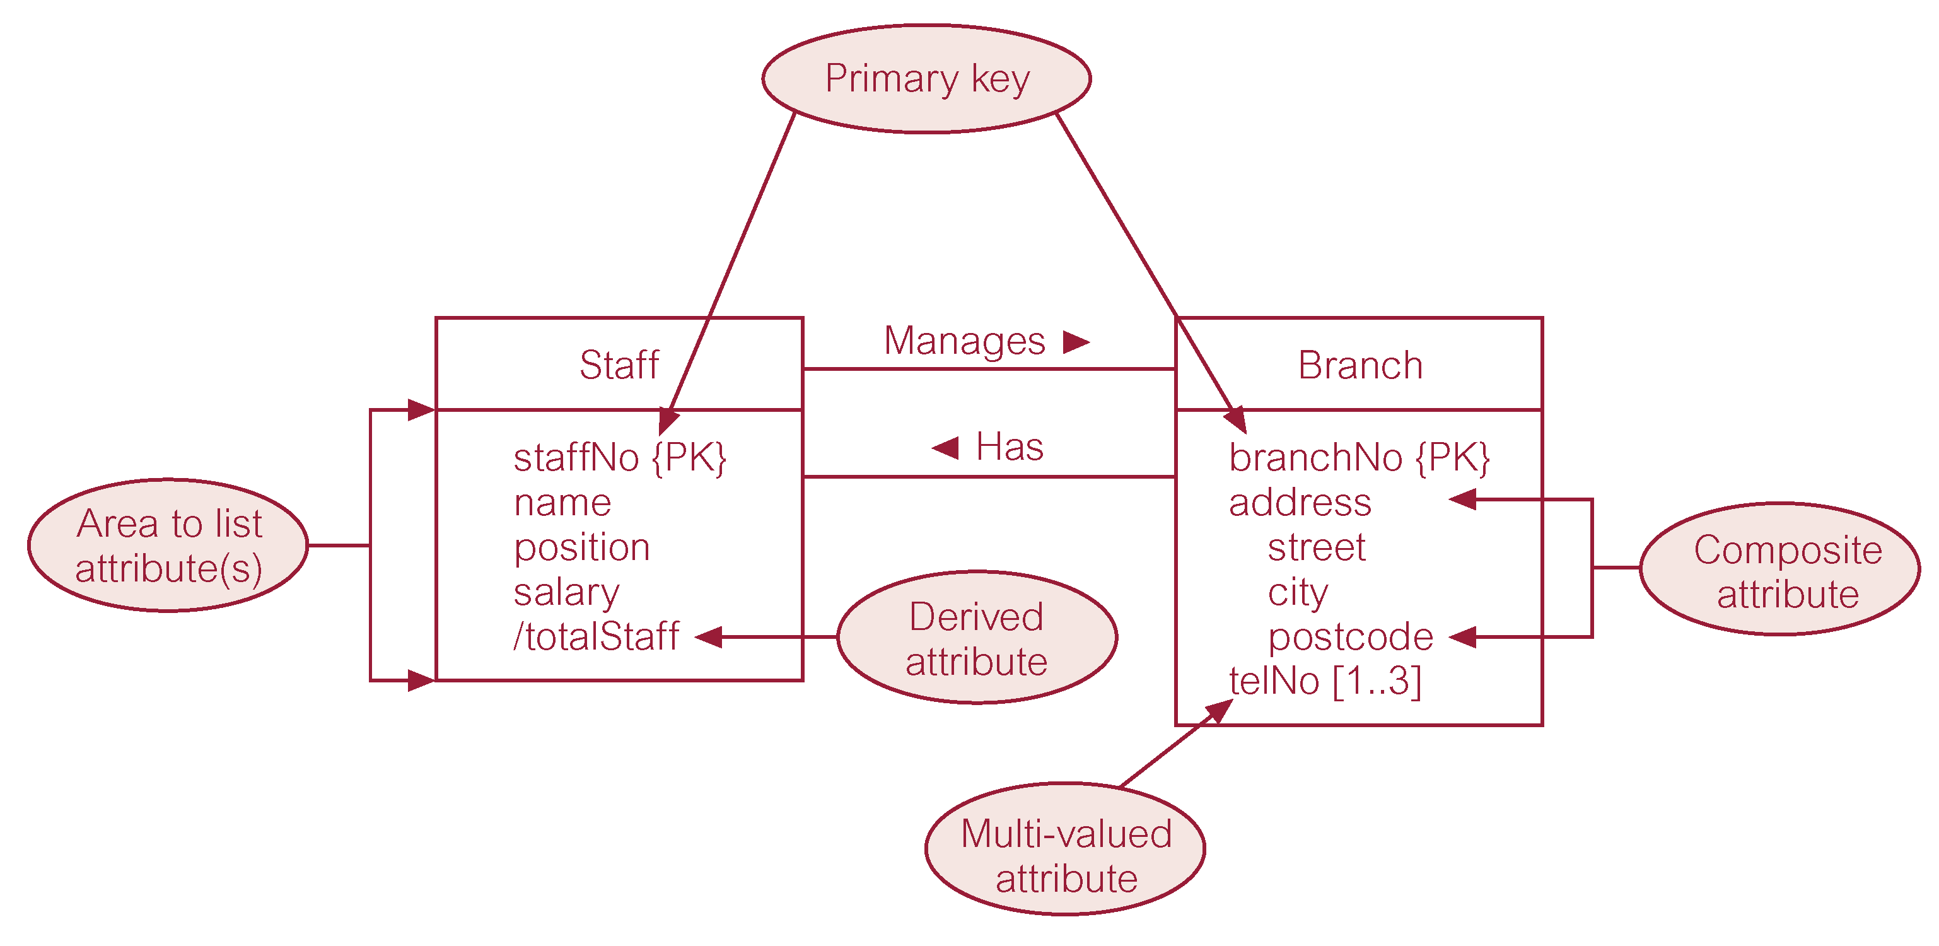
Visual Recap
1..1
0..1
0..*
0..1

Slide 27
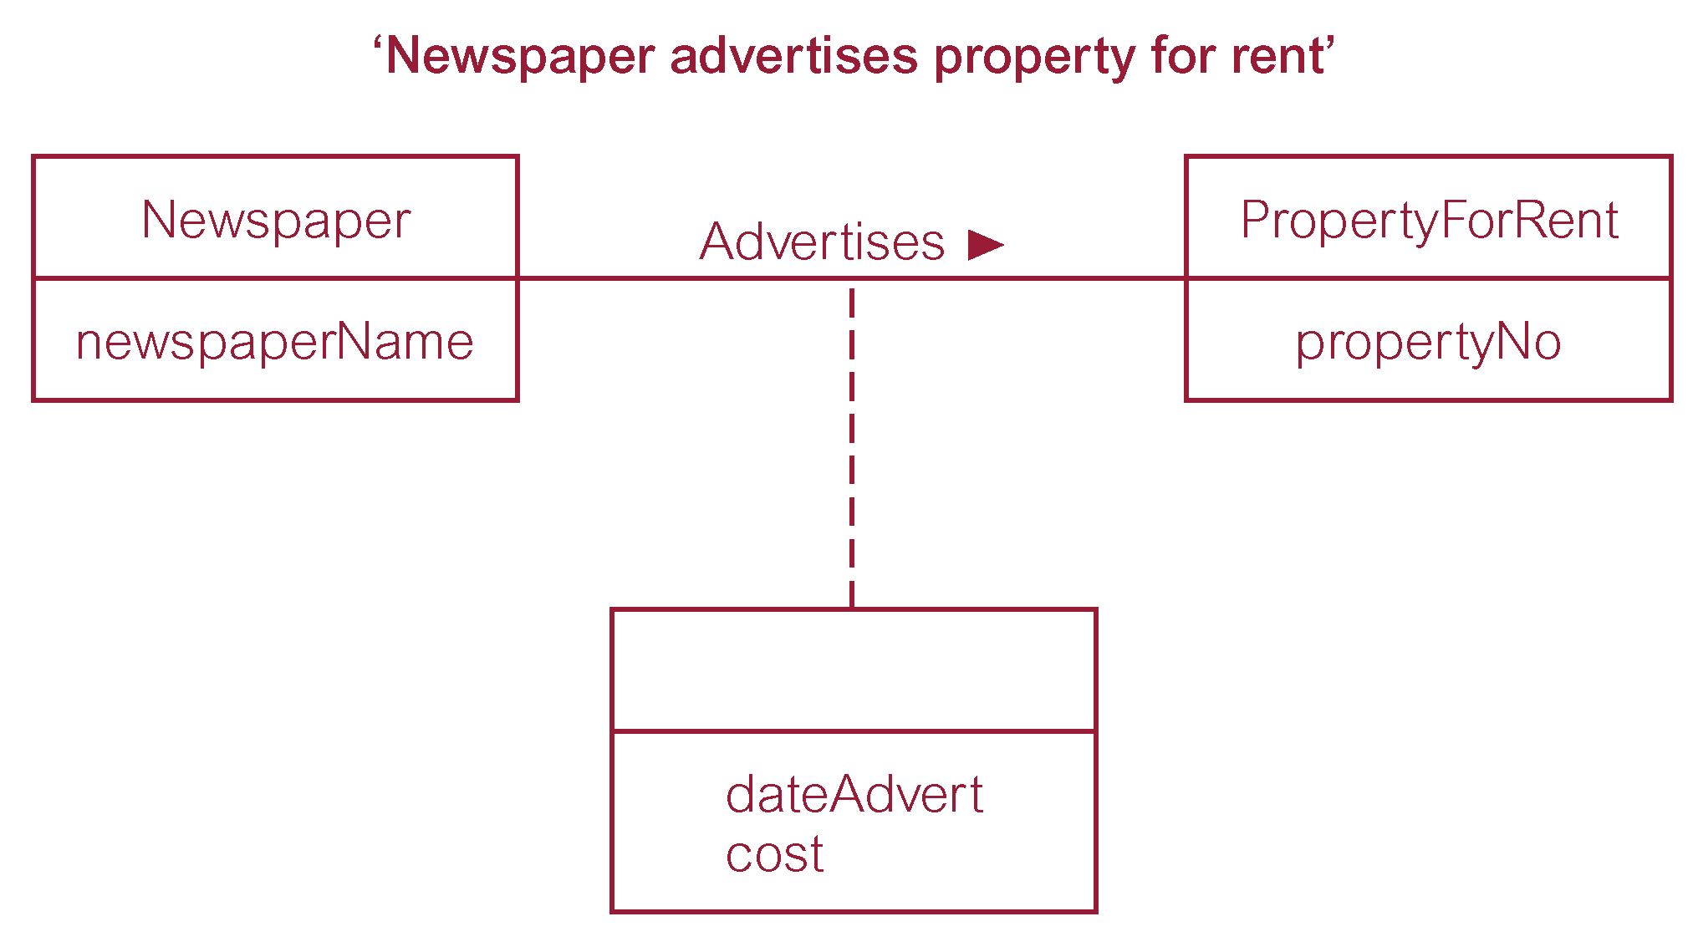
Attributes on relationships
In rare situations where location of attributes not immediately obvious.
It may indicate that relationship conceals unidentified entity.

Slide 28
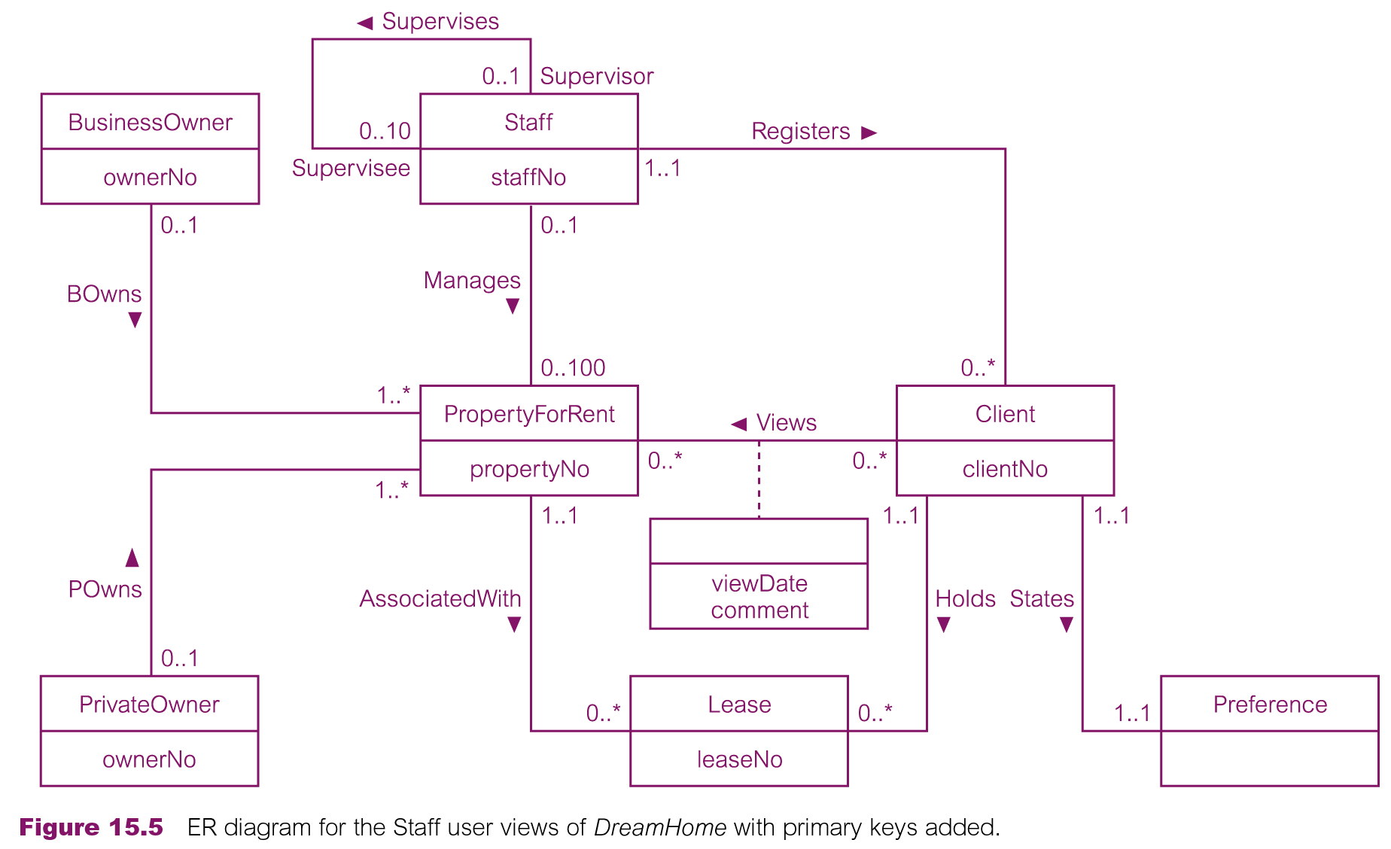
DREAMHOME Conceptual ERD (Staff View with PKs)

Slide 29
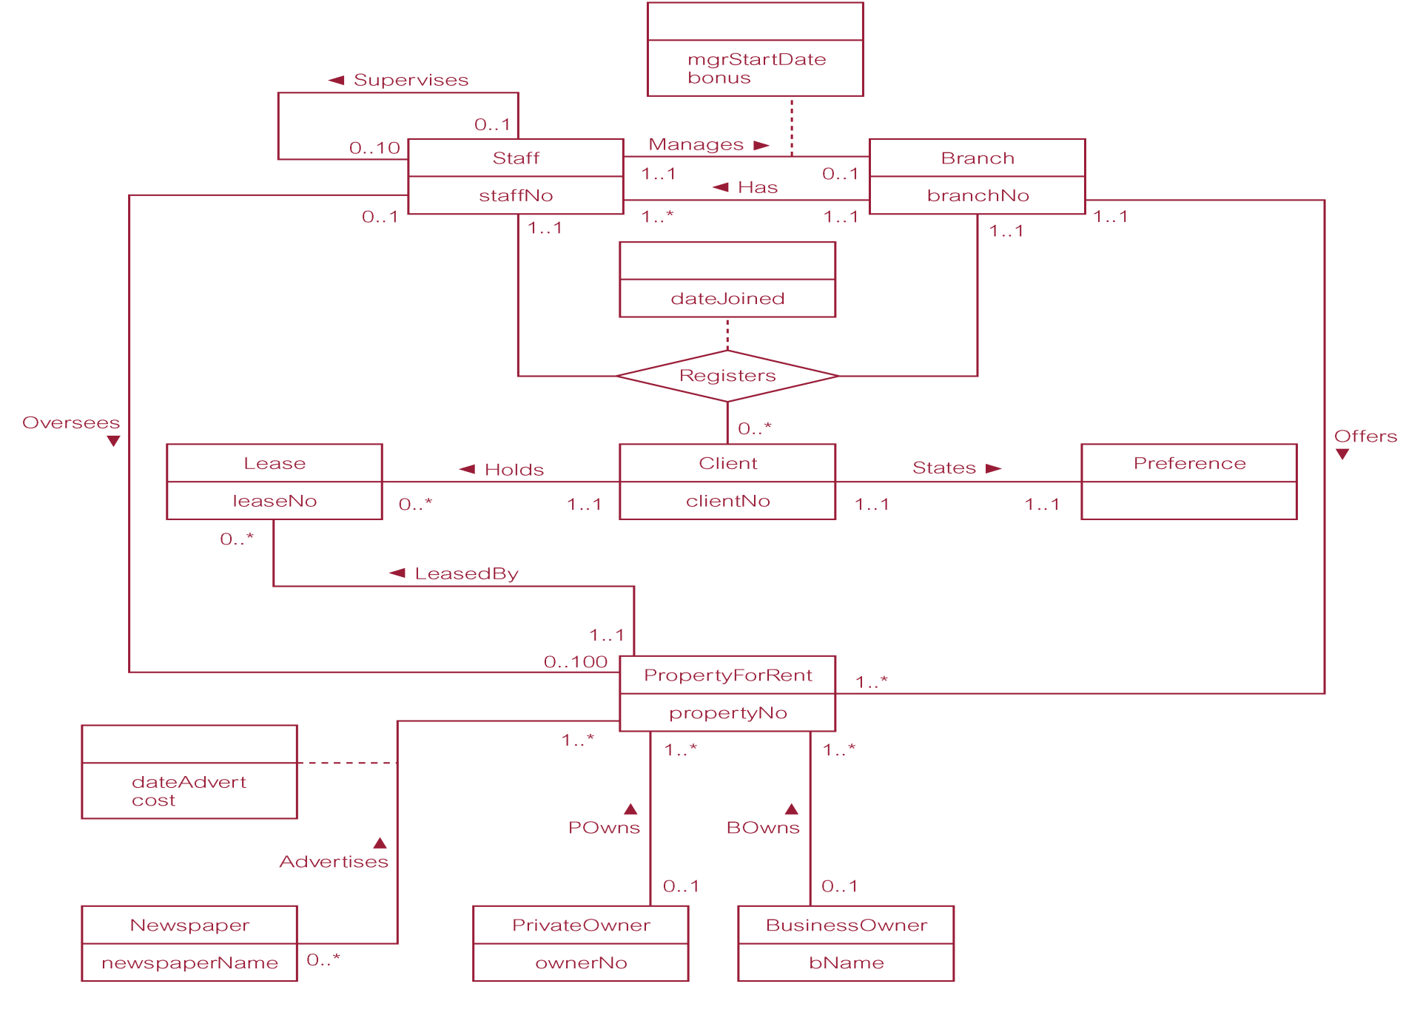
DreamHome Conceptual ERD (Branch View with PKs)

Slide 30
References and Essential Readings
Module Reading List: https://rl.talis.com/3/westminster/lists/2CAA7D6B-DCAD-AB71-C97B-7FEFCB499C28.html
Connolly, T. & Begg, C. E. (2015). Database systems: a practical approach to design, implementation and management. 6th Edition (Global Edition). Pearson Education. Ch. 1, 12, 13, 16.
Elmasri, R. & Navathe, S. (2017). Fundamentals of Database Systems. 7th Edition (Global Edition). Pearson Education. Ch. 1, 2, 3.

